Slide 1

Generative Adversarial Networks (GANs)

Slide 2
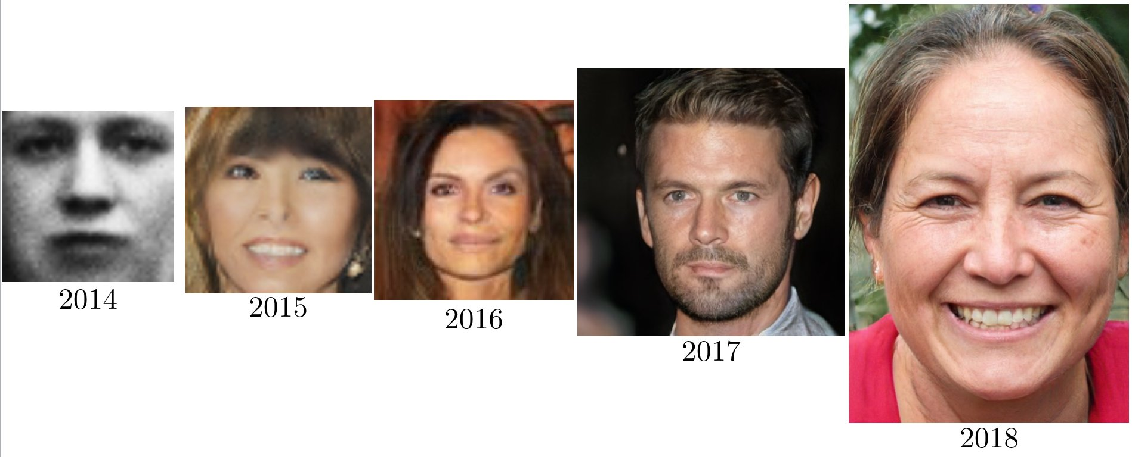
Definition
Generative Adversarial Networks (GANs) are a class of machine learning frameworks designed by Ian Goodfellow and his colleagues in 2014.
They consist of two neural networks, the Generator and the Discriminator, which contest with each other in a two-player zero-sum game framework.

Slide 3
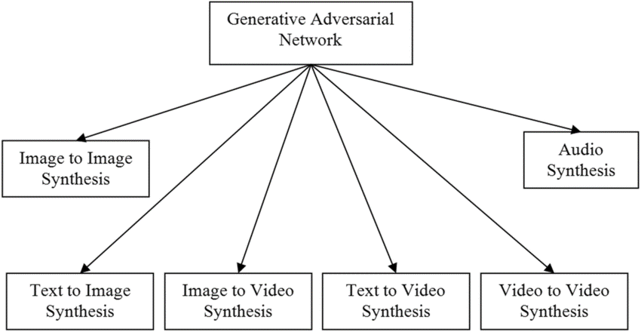
Applications
Data augmentation
Image/Video Generation and Enhancement
Anomaly Detection
Figure 1
Fig. 1/2: A comprehensive survey on generative adversarial networks used for synthesizing multimedia content - Scientific Figure on ResearchGate. Available from: https://www.researchgate.net/figure/Evolution-of-GAN-model-year-wise_fig1_369641514 [accessed 7 Jul, 2024]

Slide 4
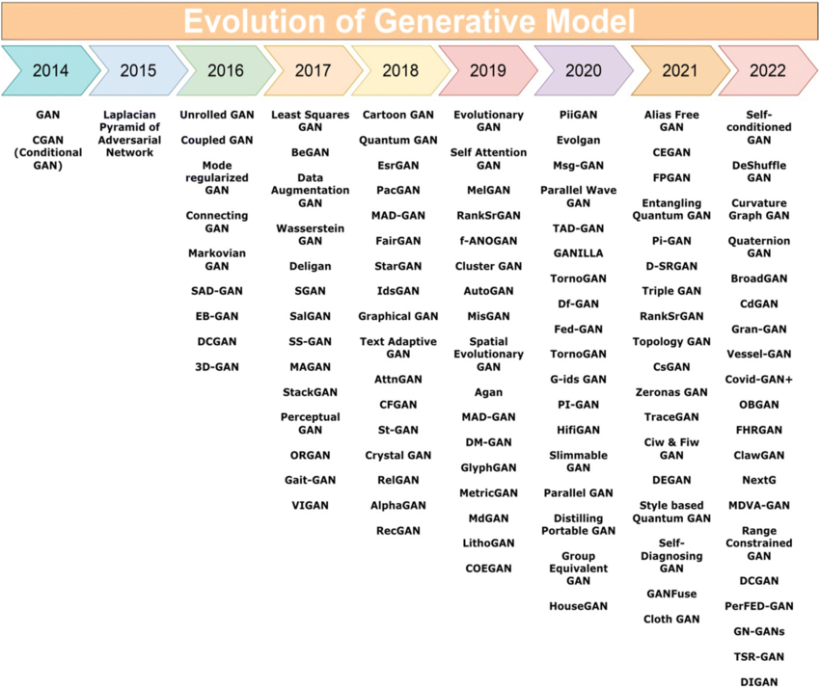
Figure 2

Slide 5
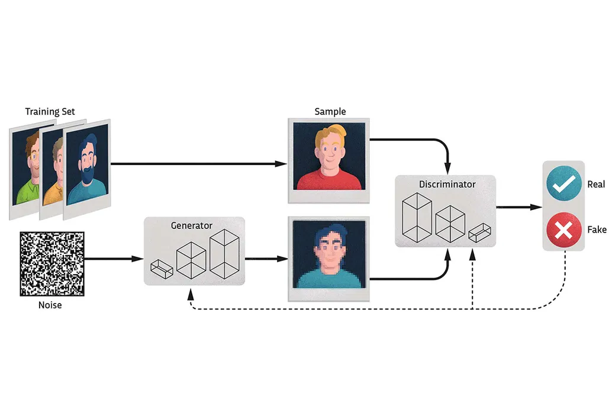
First Look
Figure 3
Notes:
Neural networks have been used as discriminative models. Which means given input data, the model will map it to a certain label.
Instead of predicting the class probability, Y, given certain input features, X, it tries to predict the probability of the input features X, given a class Y.

Slide 6
Networks
Generator
This is the generative model
Takes a probability distribution (random noise) as input
Discriminator
Takes two types of input: Real and Fake (generated by the Generator)
Tries to determine whether the input comes from the real or fake dataset
Notes:
These networks are trained together as a system. The D tries to get better at distinguishing real and fake data. On the other hand, G tries to generate more realistic samples so that It can deceive the D.
The ultimate goal of the system is to make the G so good that the D can’t distinguish between real and fake data.
The D is performing classification (binary), but the G is unsupervised since it doesn’t need labels for the data.

Slide 7
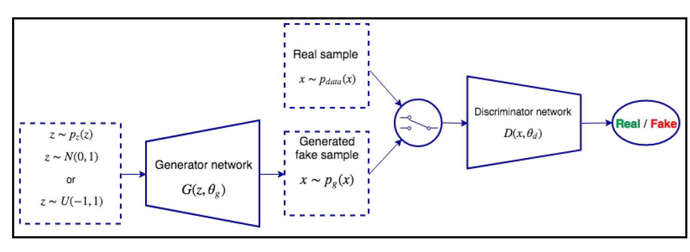
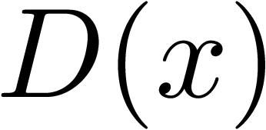
Notations
Figure 4
Generator and Discriminator loss functions: J^{(D)} and J^{(G)}
Notes:
The input to G is z, which is like a random seed value to kickstart the sample-generation process. Z has a probability distribution pz(z) which is usually a normal distribution N.
The Generator network denoted as G(z,θg) where θg : network weights.
The G outputs samples X with a probability distribution pg(x), which we can think of as the probability distribution of the real data according to the generator.
D is a binary classifier where 1 is real and 0 is fake. Thus, the two types of input in this classifier are the generated fake samples from G, and real data with x~pdata(x). The Discriminator network denoted as D(x, θd) where θd: network weights.
To summarise, To learn the generator’s distribution pg over data x, we define a prior on input noise variables pz(z), then represent a mapping to data space as G(z; θg), where G is a differentiable function represented by a multilayer perceptron with parameters θg. We also define a second multilayer perceptron D(x; θd) that outputs a single scalar. D(x) represents the probability that x came from the data rather than pg. We train D to maximize the probability of assigning the correct label to both training examples and samples from G.

Slide 8
Training of GANs
Sequential minimax zero-sum game of two players.
Sequential: Taking turns.
Zero-sum: Gains or losses of one network are exactly balanced by the gains or losses of the opposite network.
Minimax: The strategy is for the G to minimize the D’s maximum score, and vice versa. Constant competition.
Cost Function:
After some training, we assume the J^{(D)} and J^{(G)} are at some local minimum. The solution to the minimax game is called the Nash Equilibrium.
Notes:
(Read everything before the cost function)
In the original paper the authors describe this cost function as a minimax optimization problem and it is denoted as V
This cost function denotes the adversarial nature of GANs and resembles the binary cross entropy (without the “-”)
A Nash equilibrium happens when one of the actors doesn't change its action, regardless of what the other actor may do. In GANs, it happens when the generator becomes so good that the discriminator is no longer able to distinguish between the generated and real samples. That is, the discriminator output will always be ½ regardless of the presented input.

Slide 9
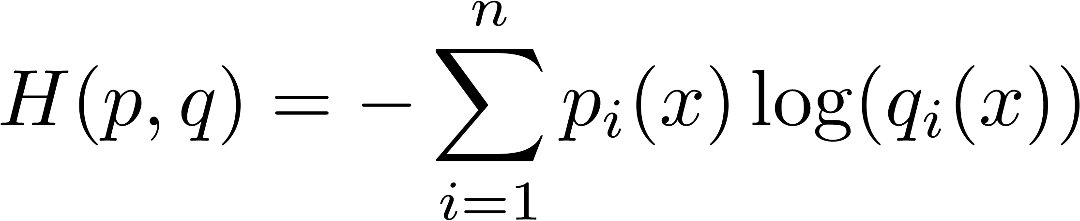
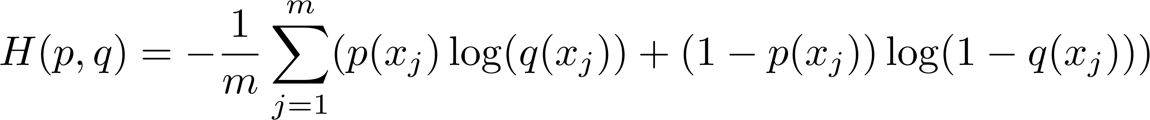
Binary Classification
Cross-entropy loss :
Binary cross-entropy loss:
Expanding the formula for a mini-batch of m samples:
Notes:
qi(x) : estimated probability of the output belonging to the i-th class.
pi(x): actual probability

Slide 10
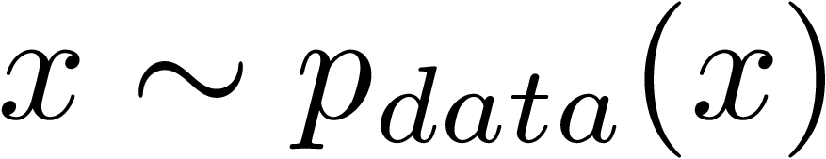
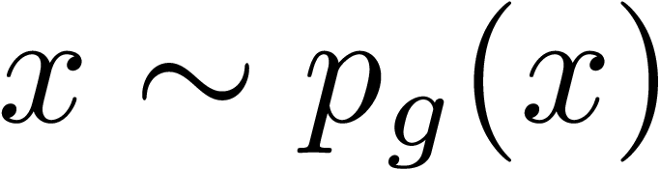
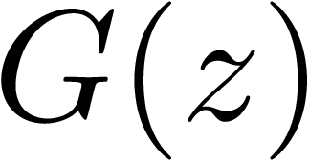
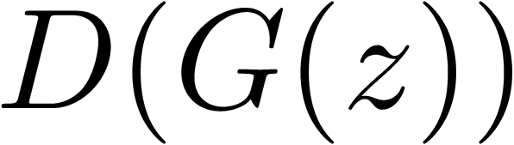
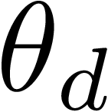
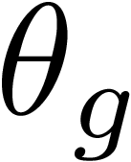
Training the Discriminator (D)
D is a classification NN, thus we can train with Gradient Descent (GD) and backpropagation. D has two inputs, real data and generated (fake) data.
We select a sample from and use it to produce .
We generate a fake sample . D and G work as a single network here. Starting from z we produce and finally we produce the final output .
We compute the cost function V and we backpropagate the error gradient and update the weights. But only and we lock so we can improve only the D.

Slide 11
Training the Discriminator (D)
Discriminator Loss:
Notes:
First term is the expectation of the log of the discriminator output when the input is from the real data distribution. Ideally, we will have D(x) = 1.
Second term is the expected value of the log of the quantity 1 minus the discriminator’s prediction on the fake samples. Same observations like the first term, however, this term is maximized when D(G(z)) = 0.
The discriminator loss will be 0 when D(x) =1 for all x~pdata(x) and D(x) = 0 for all x~pg(x).
The D tries to maximize this loss, meaning it tries to maximize the first term to be D(x) = 1 meaning its from the real data distribution, and tries to maximize the second term as D(G(z)) being 0 meaning its from the fake data distribution.
The D loss term is basically just cross-entropy loss for a binary classifier with some GAN-specific properties.
The original paper doesn’t have the ½ in the term. It also doesn’t have the minus sign. The minus sign is a conventional way for practical use in ML and because the Grad. Desc is designed to minimize a given loss function. The ½ it is used to normalize the loss and it has been seen to improve the training of the GAN framework.

Slide 12
Training the Generator (G)
Starting with a random latent vector z, we feed it through both networks to produce an output
The loss function is the same as the D, but we try to maximize it rather than minimize it. (Deceiving the D)
Similarly, we backpropagate the error gradient and update the weights. But only and we lock so we can improve only the G.
In this phase, we only use generated data and D’s weights are locked. Therefore, we can ignore that part of the loss function that deals with real data:
Notes:
In this phase, we only use generated data. Since the discriminator weights are locked, we can ignore the part of the loss function that deals with real data.

Slide 13

Training the Generator (G)
The gradient of that formula is:
Different loss function:
Notes:
The gradient is that and can be seen as an uninterrupted line. This imposes a limitation on the training, since early on, when the D can easily distinguish between real and fake samples (D(G(z)) ~~ 0) the gradient will be close to 0. This will result in little learning of the weights θg (vanishing gradient problem).
This can be solved by using a different loss function. Now the loss is still minimized when D(G(z)) ~~ 1 and when the gradient is large (generator underperforms). Note: The game is no longer zero-sum but it doesn’t have a practical effect on the GAN framework.

Slide 14
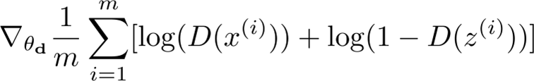
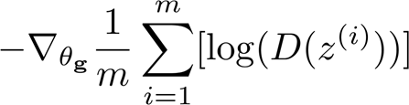
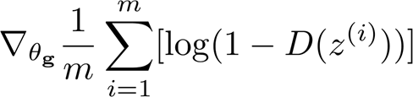
All together
for each iteration do:
for k steps do:
Sample a mini-batch of m random noise from latent space and transform with Generator
Sample a mini-batch of m real samples from the real data
Update the D weights, by ascending the stochastic gradient of its cost:
end for
Sample a mini-batch of m random noise from latent space and transform with Generator
Update the G by descending the stochastic gradient of its cost:
end for
Notes:
In short, the G tries to minimize the objective, while the discriminator tries to maximize it.
Here the authors by ascending refer to optimizing its parameters to increase its ability to correctly classify real samples as real and generated samples as generated.
While by descending refer to adjusting its parameters to minimize the discriminator's ability to differentiate between real and generated samples.

Slide 15

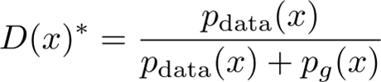


Theoretical Takeaways
Notes:
First they showed that for a static G, the maximum of the cost function, with respect to the D, is a constant number, -log(4).
After some mathematical manipulations, they derive that an optimal D can be expressed as :
We can intuitively see that if the probability distribution of the real data is equal to the probability distribution of the fake data, then the optimal D is ½. That makes sense since if the two distributions are identical, the D has to take a guess to predict which is the real one.
If we plug this into our original cost function we derive to the constant –log(4).

Slide 16
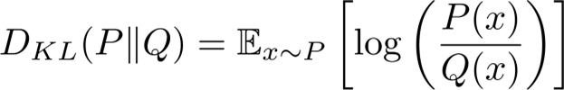
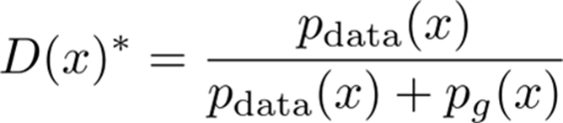
Theoretical Takeaways
Kullback–Leibler Divergence
Jensen-Shannon Divergence
Notes:
There is this function (Kullback–Leibler divergence). KL divergence is a non-symmetric metric that measures the relative entropy or difference in information represented by two distributions.
Now another theoretical takeway from the authors for G that tries to minimize the V is:
We plug into our original V the optimal D we saw before. Considering KL, we reformulate the function as:
One other definition is Jensen-Shannon Divergence. Its similar to KL Divergence but its symmetric. On a high-level, JSD is the distance measure between two probability distributions.

Slide 17
Theoretical Takeaways
0
Notes:
For an optimal D, the G is aiming to minimize this quantity.
The minimum for an JSD is 0, and this occurs IF AND ONLY IF the two probability distributions are equal.
This shows that this cost function has only one minimum and that minimum is achieved when the G perfectly maps the real data distribution.

Slide 18
Problems with training GANs
Pitfalls:
Gradient descent is designed to find the minimum of the loss function, rather than the Nash equilibrium. Thus, sometimes the training may fail to converge.
D output is a sigmoid function(probability being fake or real). If D becomes too good at this task, the probability output will converge to either 0 or 1 at every training sample. Therefore, the error gradient will always be 0, which prevents the generator from learning.
Similarly, if D is too bad, it will backpropagate wrong information to G. D shouldn’t be too good or too bad.
Mode Collapse: The generator can generate a limited number of data, regardless of the latent input vector value.
Notes:
3rd bullet : In practice this means we cannot train until convergence.
4th bullet : This can happened because the loss function doesn’t force the generator to create a unique data x for different values of the input latent vector. Thus the generator can produce limited or repetitive samples that fail to cover the diversity present in the original data. As a result, the generator might converge to a limited set of outputs that are easier to generate and fool the discriminator, rather than exploring the full diversity of the training data.

Slide 19
Conditional GANs
Notes:
CGAN is an extension of the GAN model where both the generator and discriminator receive some additional conditioning input information

Slide 20
References
Goodfellow, I., Pouget-Abadie, J., Mirza, M., Xu, B., Warde-Farley, D., Ozair, S., ... & Bengio, Y. (2014). Generative adversarial nets. Advances in neural information processing systems, 27.
Ivan Vasilev - Advanced Deep Learning with Python_ Design and implement advanced next-generation AI solutions using TensorFlow and PyTorch-Packt Publishing (2019)
Mirza, M., & Osindero, S. (2014). Conditional generative adversarial nets. arXiv preprint arXiv:1411.1784.

